Slide 1

1. A 400-V dc shunt motor takes a current of 5.6 A on no-load and 68.3 A on full-load. Armature reaction weakens the field by 3%. Calculate the ratio of full-load speed to no-load speed. Given Ra = 0.18 ohm, brush voltage drop = 2 V, Rf = 200 ohm.

Slide 2
2. A 250-V dc shunt motor has Rf = 150 ohm and Ra = 0.6 ohm. The motor operates on noload with a full field flux at its base speed of 1000 rpm with Ia = 5 A. If the machine drives a load requiring a torque of 100 Nm, calculate armature current and speed of motor. If the motor is required to develop 10 kW at 1200 rpm, what is the required value of the external series resistance in the field circuit? Neglect saturation and armature reaction.

Slide 3

3. A 4-pole series-wound fan motor draws an armature current of 50 A, when running at 2000 rpm on a 230 V dc supply with four field coil connected in series. The four field coils are now connected in two parallel groups of two coils in series. Assuming the flux/pole to be proportional to the exciting current and load torque proportional to the square of speed, find the new speed and armature current. Neglect losses. Given: armature resistance = 0.2 W, resistance of each field coil = 0.05 W.

Slide 4
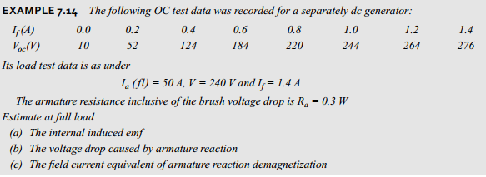
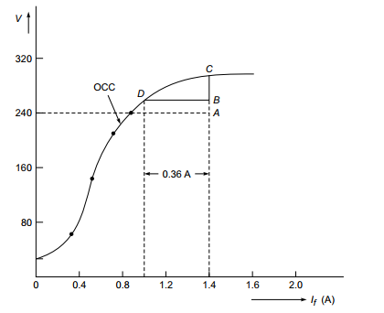
Ans: a) 255 V
b) 21 V
c) 0.0072

Slide 5
6. A 220V D.C shunt motor takes 22A at rated case voltage and runs at 1000rpm. Its field resistance is 100ohm and its armature circuit resistance is 0.12. The value of additional resistance required in the armature circuit to reduce the speed to 800rpm when a) load torque is proportional to the speed b) load torque varies as the square of the speed
Ans: a) 2.778 ohm
b) 3.497 ohm

Slide 6
A 200 V D.C. shunt motor takes 4 A at no-load when running at 700 r.p.m. The field resistance is 100ohm. The resistance of armature at standstill gave a drop of 6V across armature terminals when 10A were passed through it. Full load power input of the motor is 8kW. Calculate speed on full load.
Ans: 624 rpm

Slide 7
A 220 V separately excited de motor has Ra 0.5 2, takes I, = 40 A at full load. By how much should the flux be reduced to increase the speed by 50% if the torque is constant?
Ans: 37.5%

